Slide 1
Advanced DDL and DML Statements
CSIT882: Data Management Systems
Notes:
<!-- Neural, Brian, Male, British English. -->
<speak>
<break time="0.5s"/>
<prosody rate="90%">
Advanced Data Definition and Data Manipulation Language statements.
<break time="0.3s"/>
This presentation explains the applications of TRUNCATE TABLE statement.
<break time="0.5s"/>
</prosody>
</speak>
1
Systems Analysis

Slide 2
Outline
TRUNCATE TABLE statement
CREATE TABLE statement with subquery
INSERT statement with subquery
DELETE statement with subquery
UPDATE statement with subquery
2
Notes:
<!-- Neural, Brian, Male, British English. -->
<speak>
<break time="0.5s"/>
<prosody rate="90%">
TRUNCATE TABLE statement.
<break time="0.5s"/>
</prosody>
</speak>
Systems Analysis
2

Slide 3
TRUNCATE TABLE statement
TRUNCATE TABLE statement permamently deletes all rows from a relational table
TRUNCATE TABLE statement is a Data Definition Language (DDL) statement and because of that it cannot be reversed (in the futre we shall learn how to reverse DML statements)
TRUNCATE TABLE statement does not have WHERE clause and because of that it can only delete ALL rows from a relational table
TRUNCATE TABLE statement deletes all rows much faster than DELETE statement because database system does not need to save rollback information
TRUNCATE TABLE statement returns unused persistent storage to a pool of free persistent storage while DELETE statement does not do that
3
Notes:
<!-- Neural, Brian, Male, British English. -->
<speak>
<break time="0.5s"/>
<prosody rate="90%">
TRUNCATE TABLE statement permanently deletes all rows from a relational table, such that the deletions cannot be rolled back.
<break time="0.3s"/>
The deletions cannot be rolled back, because TRUNCATE TABLE statement is a Data Definition Language, D D L statement.
<break time="0.3s"/>
TRUNCATE TABLE statement does not have WHERE clause and because of that, it can only delete ALL rows from a relational table.
<break time="0.3s"/>
TRUNCATE TABLE statement deletes all rows much faster than DELETE statement, because database system does not need to save rollback information.
<break time="0.3s"/>
TRUNCATE TABLE statement returns unused persistent storage, to a pool of free persistent storage, while DELETE statement does not do that.
<break time="0.3s"/>
TRUNCATE TABLE statement does not delete a definition of a relational table from a data dictionary.
<break time="0.3s"/>
TRUNCATE TABLE statement is recommended, when we would like to delete the large amounts of data and we know well what we are doing, because the only way to restore data is from a backup, if we have one ?
<break time="0.5s"/>
</prosody>
</speak>
Systems Analysis
3

Slide 4

TRUNCATE TABLE statement
For example, delete all courses from a relational table COURSE
TRUNCATE TABLE COURSE;
4
Notes:
<!-- Neural, Brian, Male, British English. -->
<speak>
<break time="0.5s"/>
<prosody rate="90%">
For example, to delete all courses from a relational table: COURSE, we use a statement: TRUNCATE TABLE COURSE.
<break time="0.3s"/>
Note, that TRUNCATE TABLE statement still enforces the referential integrity constraints.
<break time="0.3s"/>
It means, that in our case, a relational table: DEPARTMENT, cannot be truncated before a relational table: COURSE.
<break time="0.5s"/>
</prosody>
</speak>
Systems Analysis
4

Slide 5
Outline
TRUNCATE TABLE statement
CREATE TABLE statement with subquery
INSERT statement with subquery
DELETE statement with subquery
UPDATE statement with subquery
5
Notes:
<!-- Neural, Brian, Male, British English. -->
<speak>
<break time="0.5s"/>
<prosody rate="90%">
CREATE TABLE statement with subquery.
<break time="0.5s"/>
</prosody>
</speak>
Systems Analysis
5

Slide 6
CREATE TABLE statement with subquery
CREATE TABLE statement with subquery creates a new relational table and saves in the table the results of the processing of the subquery
CREATE TABLE statement with subquery is Data Definition Language (DDL) statement and its actions cannot be reversed
A relational table created by CREATE TABLE statement with a subquery does not enforce any consistency constraints except NULL/NOT NULL constraint
For example, "create a table that contains the names of departments together with the total number of courses offered by each department and insert correct data into the table”
CREATE TABLE DCNT AS
( SELECT name, COUNT(cnum) TOTC
FROM DEPARTMENT LEFT OUTER JOIN COURSE
ON DEPARTMENT.name = COURSE.offered_by
GROUP BY name );
6
Notes:
<!-- Neural, Brian, Male, British English. -->
<speak>
<break time="0.5s"/>
<prosody rate="90%">
CREATE TABLE statement with subquery creates a new relational table, and saves in the table the results of processing of subquery.
<break time="0.3s"/>
CREATE TABLE statement with subquery is Data Definition Language, D D L statement and its actions cannot be rolled back.
<break time="0.3s"/>
A relational table, created through processing of CREATE TABLE statement with a subquery, does not enforce any consistency constraints, except NULL NOT NULL constraint.
<break time="0.3s"/>
The other consistency constraints must be enforced manually with ALTER TABLE statement.
<break time="0.3s"/>
For example, we would like to create a new relational table, that contains the names of departments, together with the total number of courses offered by each department and we would like to automatically, insert the correct data into the table.
<break time="0.3s"/>
To do so, we use CREATE TABLE statement with: AS clause, following a name of a new relational table: D C N T.
<break time="0.3s"/>
AS clause, replaces a list of column and constraint definitions, in an ordinary CREATE TABLE statement.
<break time="0.3s"/>
AS clause is followed by SELECT statement, that implements a subquery finding the names of departments and the total number of courses offered by each department.
<break time="0.3s"/>
It is a typical SELECT statement, with GROUP BY clause and aggregation function: COUNT.
<break time="0.3s"/>
The names of the columns in the new relational tables are taken from the names of the columns, used in SELECT clause of SELECT statement implementing a subquery.
<break time="0.3s"/>
If a function is used in SELECT clause, like in the example in the present slide, then to give a name to a column, that contains the results of the function we use: an alias name.
<break time="0.3s"/>
Alias name immediately follows a function in SELECT clause, like a name: TOT C, following COUNT c num in the current example.
<break time="0.3s"/>
Note, that subquery must be represented as an inline view and it means, that SELECT statement implementing a subquery must be enclosed within the left and right brackets.
<break time="0.3s"/>
There is no need to provide a name to an inline view.
<break time="0.3s"/>
A sample implementation of CREATE TABLE statement with a subquery, is given at the bottom of the present slide.
<break time="0.5s"/>
</prosody>
</speak>
Systems Analysis
6

Slide 7
CREATE TABLE statement with subquery
The consistency constraints can be enforced with ALTER TABLE statement
ALTER TABLE DCNT ADD CONSTRAINT DCNT_pkey PRIMARY KEY(name);
ALTER TABLE DCNT ADD CONSTRAINT DCNT_fkey FOREIGN KEY (name)
REFERENCES DEPARTMENT(name);
7
Notes:
<!-- Neural, Brian, Male, British English. -->
<speak>
<break time="0.5s"/>
<prosody rate="90%">
After a new relational table is created, the consistency constraints can be enforced with ALTER TABLE statement.
<break time="0.3s"/>
A column: name, in a new relational table D C N T becomes a primary key because, grouping in SELECT statement has been done over a column: name.
<break time="0.3s"/>
A column: name, is also a foreign key in a relational table D C N T because all of its values must come from a respective column: name, in a relational table: DEPARTMENT, were a column: name, is a primary key.
<break time="0.3s"/>
Note, that CREATE TABLE statement with a subquery, is a data definition language statement and it cannot be rolled back.
<break time="0.3s"/>
A new relational table: D C N T, can be dropped with DROP TABLE statement.
<break time="0.3s"/>
DELETE or TRUNCATE table statements can be used to delete all rows from a relational table D C N T.
<break time="0.3s"/>
</prosody>
</speak>
Systems Analysis
7

Slide 8
Outline
TRUNCATE TABLE statement
CREATE TABLE statement with subquery
INSERT statement with subquery
DELETE statement with subquery
UPDATE statement with subquery
8
Notes:
<!-- Neural, Brian, Male, British English. -->
<speak>
<break time="0.5s"/>
<prosody rate="90%">
INSERT statement with subquery.
<break time="0.5s"/>
</prosody>
</speak>
Systems Analysis
8

Slide 9
INSERT statement with subquery
INSERT statement with subquery inserts into a relational table the rows retrieved by a given subquery
INSERT statement with subquery is Data Manipulation Language (DML) statement and because of that its actions can be reversed with ROLLBACK statement
For example, to enforce the consistency constraints from very beginning we create a relational table DCNT first
CREATE TABLE DCNT(
name VARCHAR(50) NOT NULL,
total_courses DECIMAL(2) NOT NULL,
CONSTRAINT DCNT_pkey PRIMARY KEY(name),
CONSTRAINT DCNT_fkey FOREIGN KEY (name)
REFERENCES DEPARTMENT(name) );
9
Notes:
<!-- Neural, Brian, Male, British English. -->
<speak>
<break time="0.5s"/>
<prosody rate="90%">
INSERT statement with a subquery, inserts into a relational table, the rows retrieved by a given subquery.
<break time="0.3s"/>
INSERT statement with a subquery, is a Data Manipulation Language, D M L statement and because of that its actions can be rolled back.
<break time="0.3s"/>
Assume, that we would like to create a new relational table: D C N T, that contains the names of departments, together with the total number of courses offered by each department.
<break time="0.3s"/>
This time, to enforce, from very beginning, all consistency constraints, we create a relational table: D C N T first together with all consistency constraints enforced.
<break time="0.3s"/>
CREATE TABLE statement, that creates a relational table: D C N T, is given at the bottom of the present slide.
<break time="0.5s"/>
</prosody>
</speak>
Systems Analysis
9

Slide 10
INSERT statement with subquery
Then we use INSERT statement with subquery to load data into a relational table DCNT
INSERT INTO DCNT
( SELECT name, COUNT(cnum)
FROM DEPARTMENT LEFT OUTER JOIN COURSE
ON DEPARTMENT.name = COURSE.offered_by
GROUP BY name );
10
Notes:
<!-- Neural, Brian, Male, British English. -->
<speak>
<break time="0.5s"/>
<prosody rate="90%">
When a relational table: D C N T, is created, we use INSERT statement with subquery, to load data into a relational table: DCNT.
<break time="0.3s"/>
A sample INSERT statement with subquery is given in the present slide.
<break time="0.3s"/>
Note, that INSERT statement with subquery does not have a keyword: VALUES, separating a table name with an optional schema, from a list of values in INSERT statement, that insert a single row.
<break time="0.3s"/>
A subquery is implemented as an inline view without a name of the view.
<break time="0.3s"/>
An inline view, is a SELECT statement with GROUP BY clause and aggregation function in SELECT clause.
<break time="0.3s"/>
It is important, that the total number and the types of the columns, in an already created relational table: DCNT, must match the number and type of columns in an inline view.
<break time="0.3s"/>
INSERT statement with subquery, is a data manipulation statement and its results can be reversed with ROLLBACK statement.
<break time="0.5s"/>
</prosody>
</speak>
Systems Analysis
10

Slide 11
Outline
TRUNCATE TABLE statement
CREATE TABLE statement with subquery
INSERT statement with subquery
DELETE statement with subquery
UPDATE statement with subquery
11
Notes:
<!-- Neural, Brian, Male, British English. -->
<speak>
<break time="0.5s"/>
<prosody rate="90%">
DELETE statement with subquery.
<break time="0.5s"/>
</prosody>
</speak>
Systems Analysis
11

Slide 12
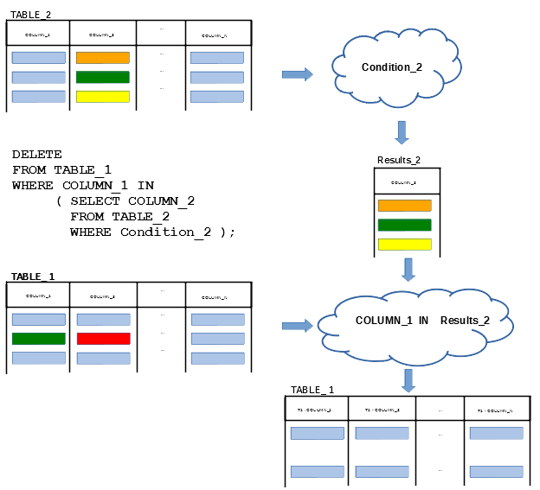
DELETE statement with subquery
DELETE statement with subquery deletes from a relational table all rows that satisfy WHERE condition
WHERE condition includes a subquery
12
Notes:
<!-- Neural, Brian, Male, British English. -->
<speak>
<break time="0.5s"/>
<prosody rate="90%">
DELETE statement with subquery operates in the same way, as DELETE statement with a simple condition in WHERE clause.
<break time="0.3s"/>
It deletes from a relational table all rows, that satisfy a condition in WHERE clause.
<break time="0.3s"/>
The only difference, is such that a condition in WHERE clause includes a number of subqueries.
<break time="0.3s"/>
A diagram given in the present slide explains a situation where we would like to delete from a relational table: TABLE 1, all rows, that have a value in column: COLUMN 1, included in a set of values from a column: COLUMN 2, that satisfy a condition: Condition 2, in a relational table: TABLE 2.
<break time="0.3s"/>
DELETE statement is interpreted in the following way.
<break time="0.3s"/>
If a subquery does not contain the references to a relational table: TABLE 1, then it is processed first and the results are saved as the results of processing of an inline view.
<break time="0.3s"/>
Next, a relational table: TABLE 1, is read row by row and a condition in WHERE clause is evaluated for each row.
<break time="0.3s"/>
If a value in a column: COLUMN 2, in the current row is included in the results of processing of inline view, then the condition evaluates to true.
<break time="0.3s"/>
If evaluation of a condition in WHERE clause returns true, then the current row is deleted from a relational table TABLE 1.
<break time="0.3s"/>
If a subquery contains the references to a relational table: TABLE 1, then the table is read row by row and like with the correlated nested queries, the references are replaced with the values from the respective rows taken from a TABLE 1.
<break time="0.3s"/>
Then, a subquery is processed for the current row and the results are stored in an inline view.
<break time="0.3s"/>
Next, a condition in WHERE clause is evaluated.
<break time="0.3s"/>
If evaluation of a condition in WHERE clause returns true, then the current row is deleted from a relational table TABLE 1.
<break time="0.3s"/>
Next, the same procedure is repeated for each row in a relational table: TABLE 1.
<break time="0.3s"/>
DELETE statement with subquery is a data manipulation language statement and its outcomes can be reversed with ROLLBACK statement.
<break time="0.5s"/>
</prosody>
</speak>
Systems Analysis
12

Slide 13
Outline
TRUNCATE TABLE statement
CREATE TABLE statement with subquery
INSERT statement with subquery
DELETE statement with subquery
UPDATE statement with subquery
13
Notes:
<!-- Neural, Brian, Male, British English. -->
<speak>
<break time="0.5s"/>
<prosody rate="90%">
UPDATE statement with subquery.
<break time="0.5s"/>
</prosody>
</speak>
Systems Analysis
13

Slide 14
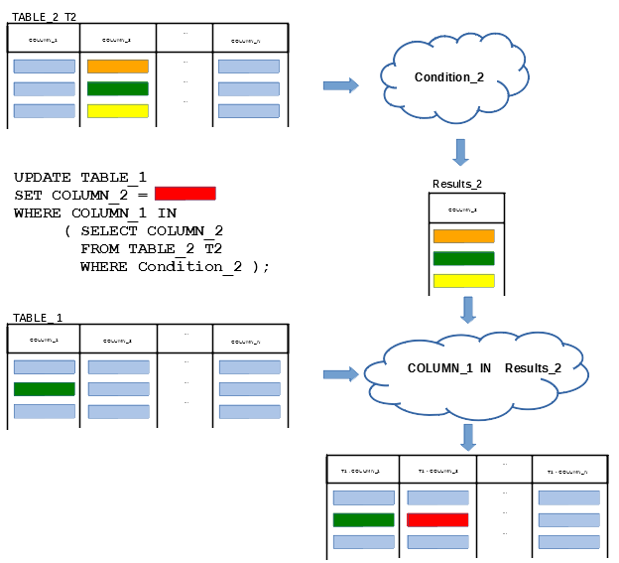
UPDATE statement with subquery
UPDATE statement with subquery updates in a relational table all rows that satisfy WHERE condition with the values determined in SET clause
UPDATE statement with subquery can use a subquery in WHERE clause
14
Notes:
<!-- Neural, Brian, Male, British English. -->
<speak>
<break time="0.5s"/>
<prosody rate="90%">
UPDATE statement with subquery, updates in a relational table all rows, that satisfy a condition given in WHERE clause.
<break time="0.3s"/>
The new values are determined in an expression in SET clause.
<break time="0.3s"/>
Both a condition in WHERE clause and an expression in SET clause can use subqueries.
<break time="0.3s"/>
The present slide explains how UPDATE statement with subquery in WHERE clause is processed.
<break time="0.3s"/>
UPDATE statement with subquery in SET clause is explained in the next slide.
<break time="0.3s"/>
UPDATE statement changes the values in a column: Column 2, in a relational table: TABLE 1, depending on the evaluation of a condition: Condition 1 in the results of subquery.
<break time="0.3s"/>
If a subquery does not contain any references to: TABLE 1, then it is processed one time and WHERE condition in UPDATE statement is changed into: COLUMN 1 IN the results of subquery.
<break time="0.3s"/>
Next, the rows from a relational table: TABLE 1, are read one by one and all rows where, a condition in WHERE clause evaluates to be true are updated.
<break time="0.3s"/>
If a subquery contains a reference to a column in a relational table: TABLE 1, then the subquery is processed for each row picked from: TABLE 1, with the reference replaced with a value taken from the current row in: TABLE 1,
<break time="0.3s"/>
A condition in WHERE clause is evaluated for each row from a relational table: TABLE 1.
<break time="0.3s"/>
If a condition in WHERE clause evaluates to be true, then a row is updated.
<break time="0.3s"/>
Such procedure is repeated for all rows in a relational table: TABLE 1.
<break time="0.5s"/>
</prosody>
</speak>
Systems Analysis
14

Slide 15
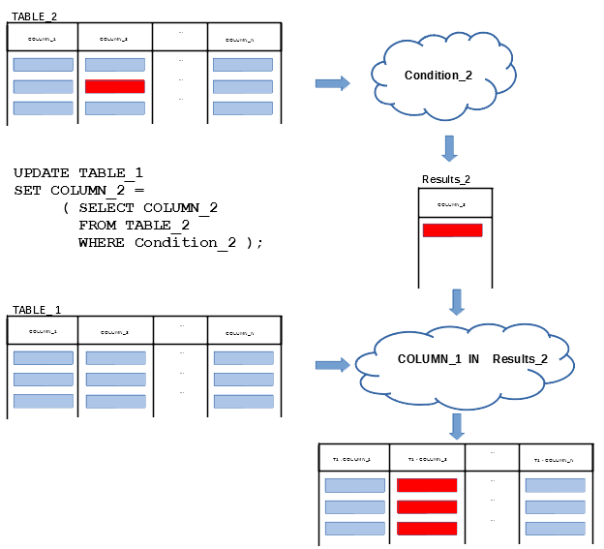
UPDATE statement with subquery
UPDATE statement with subquery can use a subquery in SET clause or in both WHERE and SET clauses
15
Notes:
<!-- Neural, Brian, Male, British English. -->
<speak>
<break time="0.5s"/>
<prosody rate="90%">
It is possible to use a subquery in SET clause of UPDATE statement, under a condition, that subquery returns at most one value.
<break time="0.3s"/>
The present slide visualises the processing of UPDATE statement, with a subquery in SET clause.
<break time="0.3s"/>
If a subquery does not contain any references to a column in updated table: TABLE 1, then the subquery is processed and a result of processing is used to update a value in a column: COLUMN 2 in a relational table: TABLE 1, in all rows, that evaluate a condition in WHERE cluase to be true.
<break time="0.3s"/>
If WHERE clause is not given, then all rows in a relational table: TABLE 1, are updated.
<break time="0.3s"/>
It is why all rows in a column: COLUMN 2, in a relational table: TABLE 1, are updated to a red colour in the present slide.
<break time="0.3s"/>
If a subquery contains a reference to a column in a relational table: TABLE 1, then the subquery is processed for each row from a relational table: TABLE 1, and a result of processing is used, to change a value in a column: COLUMN 2, in the current row.
<break time="0.3s"/>
Such procedure and processing of a subquery is repeated for all rows in a relational table: TABLE 1.
<break time="0.5s"/>
</prosody>
</speak>
Systems Analysis
15

Slide 16
UPDATE statement with subquery
For example, "increase the total number of staff members by 5 in all departments that offer more than 20 courses"
UPDATE DEPARTMENT
SET total_staff_number = total_staff_number + 5
WHERE name IN ( SELECT offered_by
FROM COURSE
GROUP BY offered_by
HAVING COUNT(cnum) > 20 );
For example, "add to table DEPARTMENT a column that contains the total number of courses offered by each department and insert the correct values into the column"
ALTER TABLE DEPARTMENT ADD ( total_courses DECIMAL(2) );
UPDATE DEPARTMENT
SET total_courses = ( SELECT COUNT(title)
FROM COURSE
WHERE COURSE.offered_by = DEPARTMENT.name );
16
Notes:
<!-- Neural, Brian, Male, British English. -->
<speak>
<break time="0.5s"/>
<prosody rate="90%">
In the first example, we implement UPDATE statement, that increases the total number of staff members by 5, in all Departments that offer more than 20 courses.
<break time="0.3s"/>
To implement UPDATE statement, we first implement a subquery, that finds the names of Departments, that offer more than 20 courses.
<break time="0.3s"/>
Such subquery can be implemented as a typical SELECT statement, with GROUP BY and HAVING clauses.
<break time="0.3s"/>
A relational table: COURSE, is grouped over the values in a column: offered by, and all groups that have less or equal 20 rows are removed.
<break time="0.3s"/>
SELECT clause of the subquery picks the values in a column: offered by, from all groups that have more than 20 rows.
<break time="0.3s"/>
Finally, UPDATE statement, picks the rows from a relational table: DEPARTMENT, and it increases total staff number by 5 in all rows where a condition: name IN the results of subquery, evaluates to be true.
<break time="0.3s"/>
In the second example, we first add to a relational table: DEPARTMENT, a column, that supposed to contain the total number of courses offered by each department.
<break time="0.3s"/>
Next, we implement UPDATE statement, that sets the correct values in the column.
<break time="0.3s"/>
We start from the implementation of: ALTER TABLE statement, that adds a column: total courses, to a relational table DEPARTMENT.
<break time="0.3s"/>
The new column has: NULL consistency constraint, because after addition the column does not contain any values.
<break time="0.3s"/>
It is possible to enforce: NOT NULL consistency constraint and provide a default value for a column: total courses.
<break time="0.3s"/>
Implementation of UPDATE statement, that sets the correct values in a column: total courses, requires a subquery in SET clause.
<break time="0.3s"/>
There is no need for WHERE clause in UPDATE statement because all rows must be updated.
<break time="0.3s"/>
The subquery in SET clause implemented as SELECT statement, finds the total number of courses offered by a given Department.
<break time="0.3s"/>
To provide information about the current Department, a condition in WHERE clause contains a reference to a column: name, in a relational table: DEPARTMENT.
<break time="0.3s"/>
UPDATE statement is processed in the following way.
<break time="0.3s"/>
A row is picked from a relational table: DEPARTMENT.
<break time="0.3s"/>
A value in a column: name, from the row replaces a reference: DEPARTMENT dot name, in WHERE condition of the subquery.
<break time="0.3s"/>
The subquery is processed and it returns a single number as the result of: COUNT title, function.
<break time="0.3s"/>
Note, that if a Department with a given name offers no courses, then the subquery returns zero.
<break time="0.3s"/>
Then, a value returned by a subquery becomes a value in a column: total courses, in the row.
<break time="0.3s"/>
The same procedure is repeated for all rows remaining in a relational table: DEPARTMENT.
<break time="0.3s"/>
</prosody>
</speak>
Systems Analysis
16

Slide 17
References
C. Coronel, S. Morris, A. Basta, M. Zgola, Data Management and Security, Chapters 5, 7, Cengage Compose eBook, 2018, eBook: Data Management and Security, 1st Edition
T. Connoly, C. Begg, Database Systems, A Practical Approach to Design, Implementation, and Management, Chapter 6.3.5 Subqueries, Chapter 6.3.8 EXISTS and NOT EXISTS, Chapter 7.4.1 Creating a View Pearson Education Ltd, 2015
D. Darmawikarta, SQL for MySQL A Beginner’s Tutorial, Chapter 7 Subqueries, Chapter 9 Views, Brainy Software Inc. First Edition: June 2014
How to ... ? Cookbook, How to implement queries in SQL ? (Part 3) Recipe 7.2 How to perform advanced data manipulations ?
17
Notes:
<!-- Neural, Brian, Male, British English. -->
<speak>
<break time="0.5s"/>
<prosody rate="90%">
References.
<break time="0.5s"/>
</prosody>
</speak>
Systems Analysis
17

